Slide 1

IFET COLLEGE OF ENGINEERING
(AN AUTONOMOUS INSTITUTION)
DEPARTMENT OF INFORMATION TECHNOLOGY
PROJECT TITLE
HYBRID NOISE REDUCTION AND ENHANCEMENT OF AUDIO QUALITY USING DEEP LEARNING
PRESENTED
BY
MAHAN.K (191061014)
GUIDED BY
Mrs. M.LIBINA, M.Tech

Slide 2
ABSTRACT
Audio noise removal using deep learning is a project aimed at improving the quality of audio signals by removing various types of noise.
A deep learning model is trained using a large dataset of noisy and clean audio signals to learn the characteristics of noise and clean signals.
The trained model can then be used to denoise new, unseen noisy audio signals, producing a cleaner output signal with improved clarity and reduced background noise.
The project has potential applications in fields such as speech processing, music production, and audio communication.

Slide 3
INTRODUCTION
Audio signals are often degraded by various types of noise, such as background noise, static, and interference, which can negatively impact the quality and clarity of the signal.
This is especially problematic in fields such as speech processing, music production, and audio communication.
Deep Learning provides a promising solution to this issue through its ability to learn complex patterns in data and make accurate predictions.
A Deep Learning model will be trained and tested on audio signals to demonstrate the potential of this approach for audio noise removal.

Slide 4
LITERATURE SURVEY
Year | Authors | Title | Publications | Techniques used | Advantages | Disadvantages
2022 | Milos Brajovic, Isidora Stankovic, Milos Dakovic, Ljubisa Stankovic | Audio Signal De-noising Based on Laplacian Filter and Sparse Signal Reconstruction. | IEEE | Compressive sensing (CS) paradigm | It is proposed to reduces impulsive noises. | Due to the time-domain based method the accuracy is lesser.
2021 | Ma Di | Research On Audio De-noising Algorithm Of Power Generation Equipment In Thermal Power Plant Based On SGN | IEEE | SGN-based audio de-noising algorithm | This algorithm has strong resilience to audio signals mixed into common noise. | Extracting noise from a audio is big process in Industries.
2020 | Saurabh Kataria, Jesus Villalba, Najim Dehak | Perceptual Loss Based Speech De noising with an Ensemble of Audio Pattern Recognition | IEEE | Deep learning based speech de-noising | Deep Speech is a multi-lingual end to-end Automatic Speech Recognition | It is not so accurate in translating.

Slide 5
Year | Authors | Title | Publications | Techniques used | Advantages | Disadvantages
2019 | Jui-Feng Yeh; Jian-Cheng Tsai; Bo-Wei Wu; Tai-You Kuang | Deep Learning-based Emotion Spatial Regression in Speech Recognition for Human-computer Interaction | IEEE | CNN-LSTM | Converts Speech Signal into text. | The time for aquiring data is slow.
2018 | S.K.Shipra Prasad, Sai Sriram Natarajan, S.Kalaivani | Analysis of the best algorithm of noise reduction from a set of algorithms | IEEE | Discrete wavelet transform technique is used | Estimates the desired random process by removing the additive noise. It reduces the mean square error in the signal. | If a signal sample is detected as a corrupted sample, it is replaced with an estimation of the true value

Slide 6
EXISTING SYSTEM
The existing system approaches for audio noise removal typically rely on signal processing techniques such as spectral subtraction, Wiener filtering, and statistical models.
These methods can effectively reduce some types of noise, but they often struggle with more complex and varying types of noise, such as non-stationary and overlapping noise.
Additionally, these methods can introduce unwanted artifacts into the clean signal and are computationally intensive, making them less suitable for real-time applications.
As a result, there is a need for a more effective and efficient solution to audio noise removal.

Slide 7
DISADVANTAGES
Inadequacy for complex noise: Traditional methods are often unable to effectively remove complex and varying types of noise, such as non-stationary and overlapping noise.
Computational Intensity: Traditional methods can be computationally intensive, making them less suitable for real-time applications.
Limited ability to learn: Traditional methods are rule-based and do not have the ability to learn from data and improve their performance.
Lack of generalization: Existing methods are often designed for specific types of noise, which limits their ability to generalize to new and unseen types of noise.

Slide 8
PROPOSED SYSTEM
The proposed system for audio noise removal leverages deep learning to address the limitations of traditional methods.
A deep learning model is trained on a large dataset of noisy and clean audio signals to learn the characteristics of both types of signals.
The trained model can then be used to denoise new, unseen noisy audio signals, producing a cleaner output signal with improved clarity and reduced background noise.
The proposed system has the potential to be more effective and efficient compared to traditional methods, especially for complex and varying types of noise.

Slide 9
ADVANTAGES
Effectiveness for complex noise: The deep learning approach can effectively remove complex and varying types of noise, such as non-stationary and overlapping noise.
Minimal artifacts introduction: The deep learning approach can produce a cleaner output signal with minimal artifacts, preserving the quality and clarity of the signal.
Efficient and real-time capable: The deep learning approach is computationally efficient, making it suitable for real-time applications.
Ability to generalize and improve: The deep learning approach can generalize to new and unseen types of noise and can continue to improve its performance through fine-tuning and retraining.
Notes:
(i.e. Partsof-Speech features, Linguistic and Word Count features and Sentimental Content features)

Slide 10
ARCHITECTURE
Pre-Processing
(Librosa library)
Design CNN Architecture
(Keras, Tensorflow)
Testing the Model
Raw Data (Input audio)
Clean Audio
Compiling the Model
(CNN)
Pre-Processing
Training the Model
Dataset (RAVDESS)

Slide 11
DATASET
Overview of the RAVDESS dataset: The ‘Ryerson Audio-Visual Database of Emotional Speech and Song’ dataset consists of audio recordings of actors speaking and singing in various emotions, providing a diverse and rich dataset for audio processing tasks.
Suitability for audio noise removal: The RAVDESS dataset can be used for training and evaluating the audio noise removal model, as it contains speech and singing signals with different levels of noise, making it suitable for the task.
Use of the RAVDESS dataset in the model: The RAVDESS dataset can be used as input to the model during training. During evaluation, the model can be tested on the RAVDESS dataset to assess its performance on real-world audio signals.

Slide 12
PRE-PROCESSING
The raw audio signals are first pre-processed using the Librosa library. This involves resampling, normalization, and segmentation of the signals into shorter segments.
Librosa library: Librosa is an open-source library for audio and music analysis in Python. It provides a suite of functions for loading, processing, and analyzing audio signals, including speech signals.
Librosa is compatible with popular machine learning libraries in Python, including Numpy, Pandas, and TensorFlow.
Librosa provides functions for loading audio signals from various file formats, including WAV, MP3, and FLAC.

Slide 13
DESIGNING CNN ARCHITECTURE
Define the model in Keras: By using the Keras API to built the architecture of the CNN, including the number of layers, the type of layers, and the number of filters in each layer.
Using TensorFlow as the backend: Set TensorFlow as the backend for Keras, which allows the CNN to be run on the TensorFlow platform for efficient training and inference.
By using Keras and TensorFlow to design and train the CNN, the model can be optimized for the specific requirements of the audio noise removal task, and its performance can be improved.

Slide 14
COMPILE THE MODEL
Define the loss function: Choose a suitable loss function, such as mean squared error or mean absolute error, to measure the difference between the predicted and actual outputs.
Select the optimization algorithm: Choose an optimization algorithm, such as stochastic gradient descent or Adam, to minimize the loss function and update the model weights.
Compile the model: Use the Keras API to compile the model, specifying the loss function, optimization algorithm, and metrics to be used during training and evaluation.

Slide 15
MODEL TRAINING
Select the number of layers: Decide on the number of layers in the CNN, considering the complexity of the task and the size of the dataset.
Choose the type of layers: Select the type of layers to use in the CNN, such as convolutional, pooling, and dense layers, based on the specific requirements of the task and the desired performance.
Determine the number of filters: Specify the number of filters in each layer, which determine the number of features that the CNN will learn.
Decide on the activation functions: Choose the activation functions to use in the different layers, such as ReLU, sigmoid, or tanh, based on the nature of the task and the desired output of the model.

Slide 16
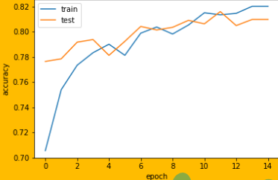
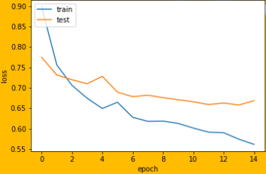
OUTPUT
Accuracy prediction
Loss prediction

Slide 17
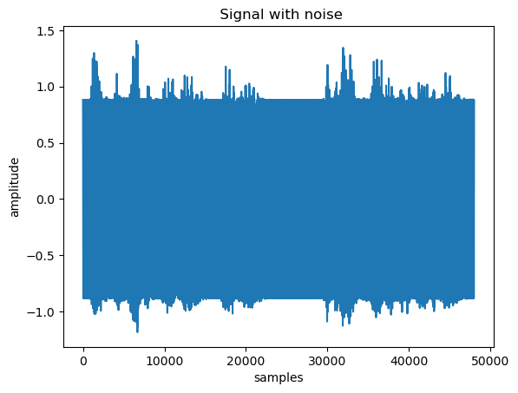
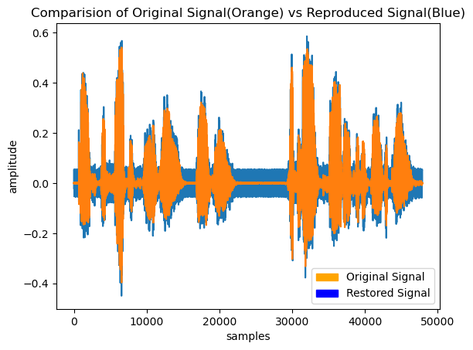
Audio with noise
Clean audio

Slide 18
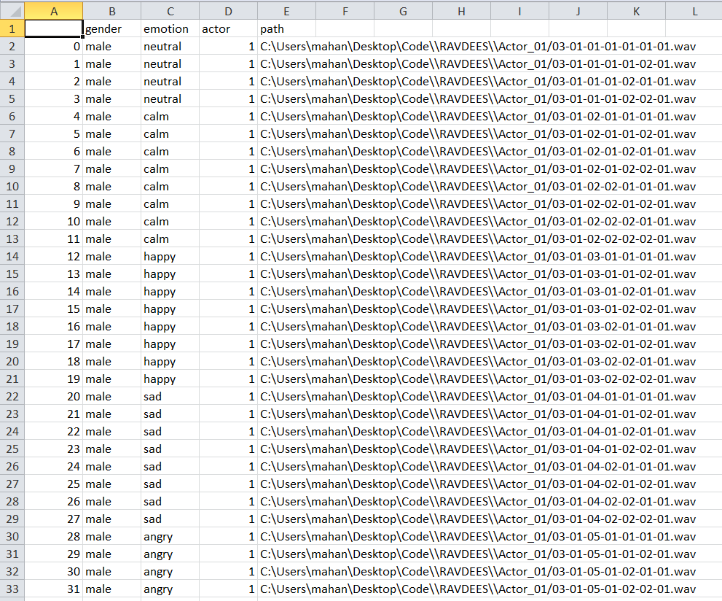
Screenshot of Dataset

Slide 19
CONCLUSION
The audio noise removal project aimed to develop a deep learning-based model to remove noise from audio signals, using the Keras and TensorFlow frameworks.
The project involved preprocessing the audio signals, designing and compiling a convolutional neural network (CNN) architecture, and training and evaluating the model on a suitable dataset, such as the Ryerson Audio-Visual Database of Emotional Speech and Song (RAVDESS).
The use of deep learning techniques allowed the model to learn from the patterns in the audio signals and effectively remove the noise, resulting in improved signal quality.

Slide 20
REFERENCES
Pascual, S., Bonafonte, A., & Serrano, J. (2017). A comparative study of deep learning techniques for music auto-tagging using audioset. arXiv preprint arXiv:1706.06642.
Xu, Y., & Narayanan, S. (2015). Regression-based probabilistic models for audio event detection and localization in domestic environments. IEEE Journal of Selected Topics in Signal Processing, 9(4), 675-687.
Fan, Y., Li, Y., & Liu, Y. (2018). A convolutional neural network for unsupervised feature learning and music tagging. arXiv preprint arXiv:1801.06669
Kim, H., Lee, H., & Lee, S. (2017). Speech enhancement using a deep denoising autoencoder. In Acoustics, Speech and Signal Processing (ICASSP), 2017 IEEE International Conference on (pp. 1335-1339). IEEE.
Pandey, P., & Narayanan, S. (2019). A deep learning framework for audio signal enhancement. arXiv preprint arXiv:1909.01338.

Slide 21
THANK YOU!

